Slide 1
Team-16 AISY
Youtube Series on ARIMA
Yash Adivarekar - 2021101008
Sankalp Bahad - 2021114015

Slide 2
The Goal
Our goal was to create a youtube series which explains the concepts of ARIMA and provides clarity to the viewer on the topic.
We aimed at creating high quality videos, using animations, giving real life examples and making the videos as interesting as possible.
We also provided a python implementation of ARIMA and explained each part of the code in detail in one of our videos.

Slide 3
Flow of work
We initially had the task of exploring the available tools for creating animations and recording videos, especially considering the computational capacity of our laptops.
We spent a considerable amount of time to explore video editing,video recording and animation tools, along with learning the basics of how to create high level visuals using those.
The next major task was to gather as many resources as possible, to understand the concepts of ARIMA well enough to be able to explain them in the videos in the best way possible, and also use those to write a code for implementation of ARIMA from scratch.
We divided ARIMA into subtopics which we would explain in the video series.

Slide 4
Flow of work (Continued.)
After gathering enough information and selecting a suitable tool for video editing,recording and animations, we started working on the scripting of the videos.
The scripting involved generating a story depicting a real world example for explanation of that particular concept and explanation of theory.
We used animations, videos, images, GIFs etc to make the videos as interesting as possible.
We created a frames for each animation and explained the concepts of ARIMA using real life examples.

Slide 5
Flow of work (Continued.)
The scripting and animation process was repeated for each video, and it was well ensured that topics are covered well with proper terminologies being used and explained.
Multiple examples were given for a topic to make sure complete and well explained knowledge is passed on.
For the python implementation of ARIMA, the code used was well documented and blocks of code were properly explained with appropriate comments in the code.
The steps in ARIMA and their significance was properly explained in the videos.

Slide 6
Following is a glimpse into what we have done in our videos.

Slide 7
This is the introductory video animation.

Slide 8
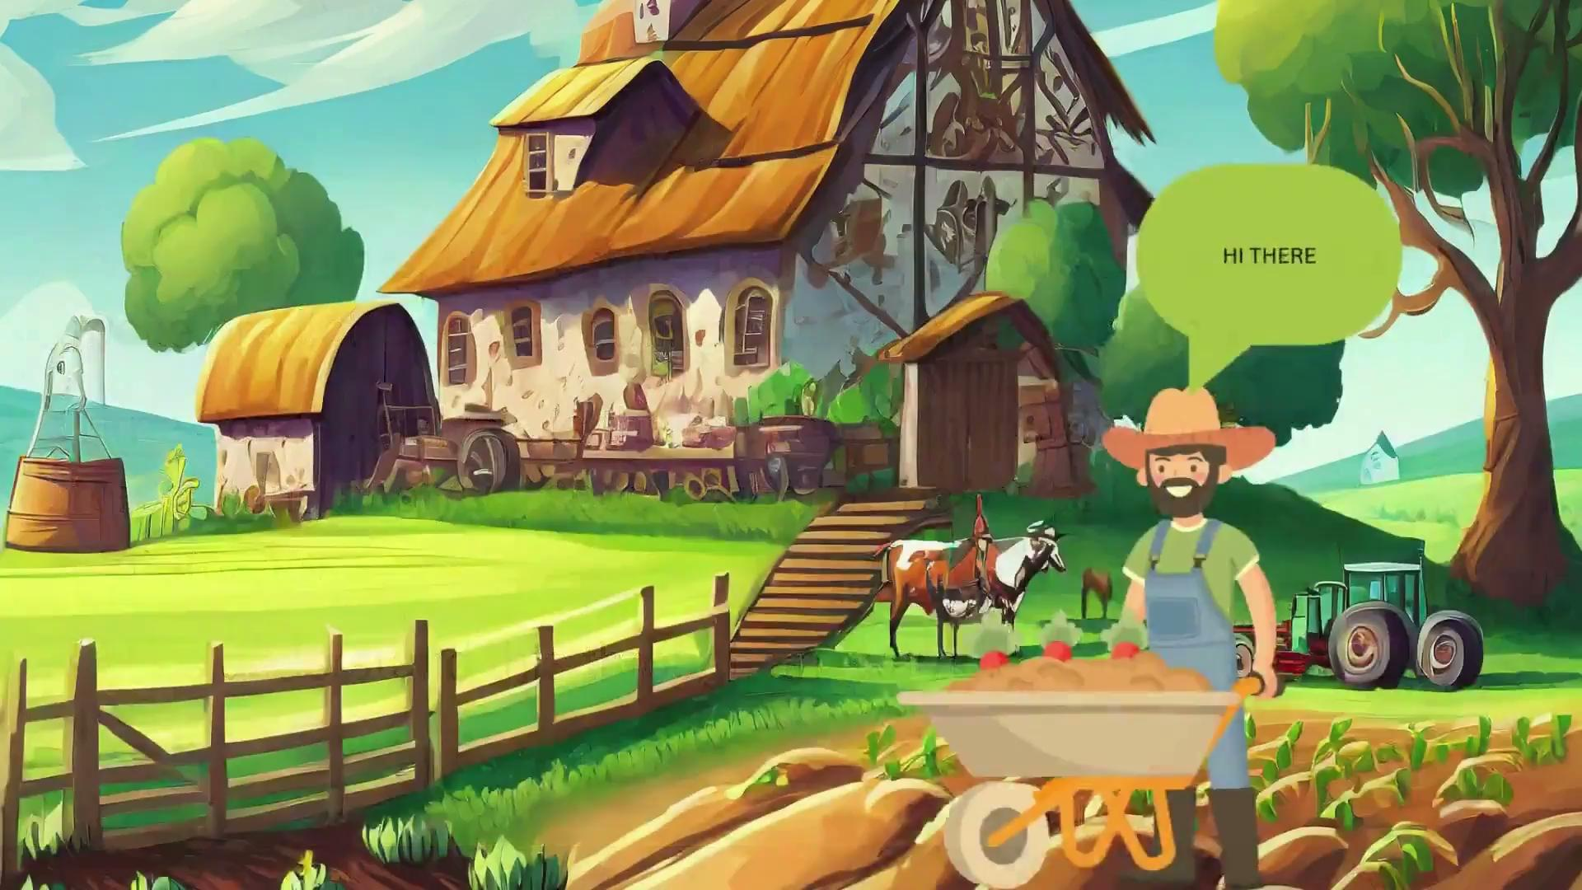

Slide 9
The next video is about the explanation of the graph in the introductory video.

Slide 10
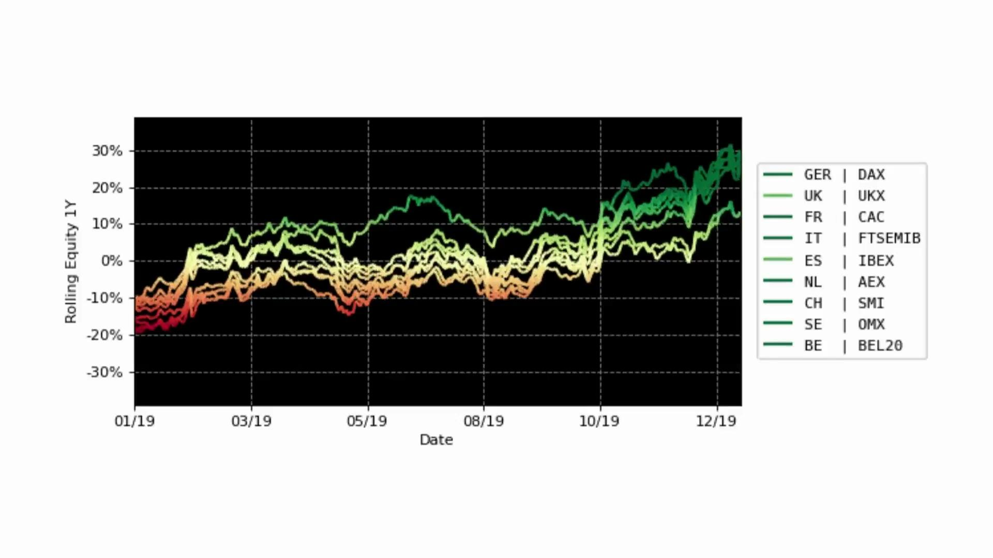

Slide 11
The second video in the series explains graphs about stationarity and seasonality

Slide 12
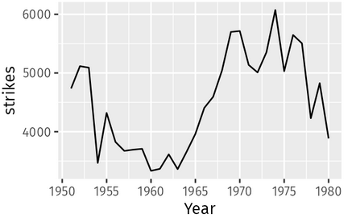

Slide 14
Not Stationary

Slide 15
This is an animation from the third video, about AutoRegression

Slide 16
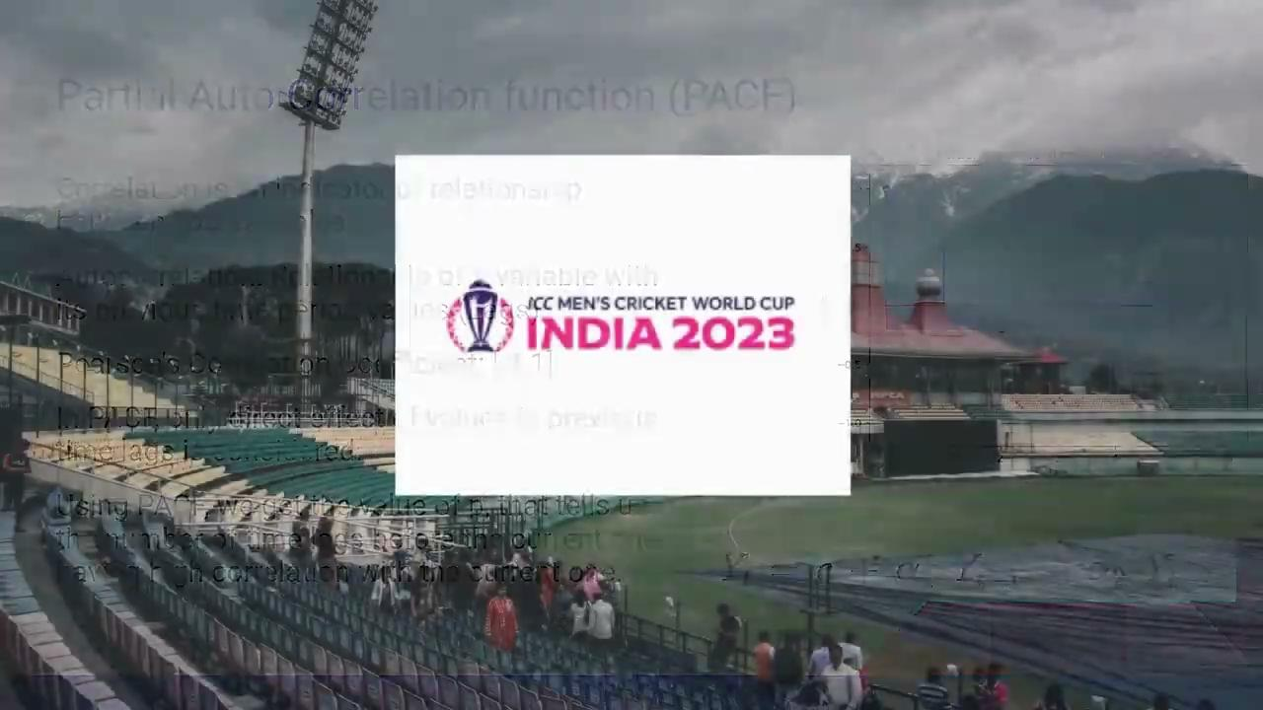

Slide 17
This is an animation from the fourth video, about Moving Average

Slide 18
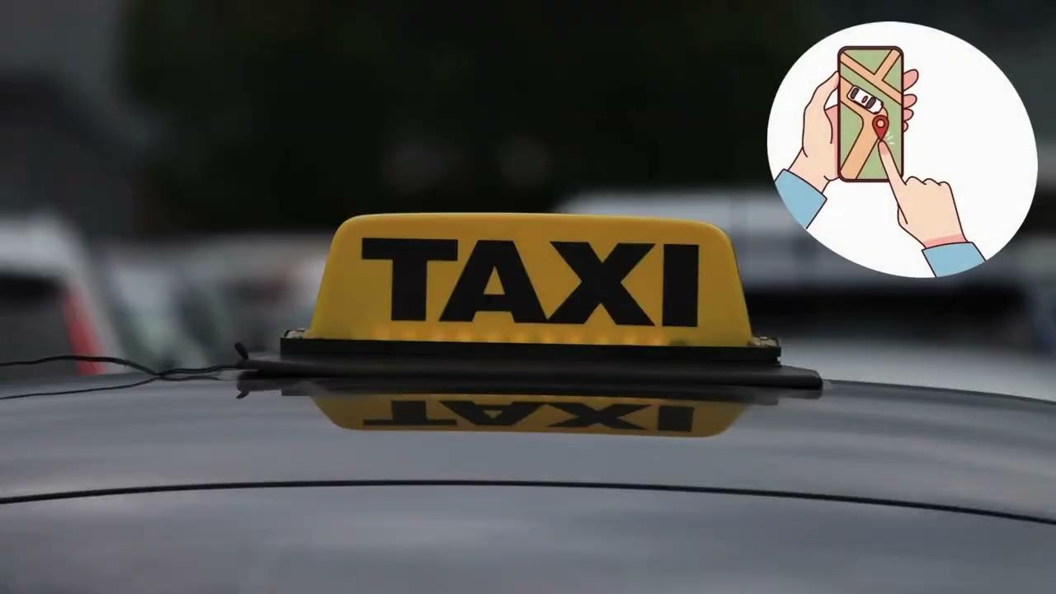

Slide 19
The next two are the animations from our final video, explaining differencing and ARIMA

Slide 20


Slide 21
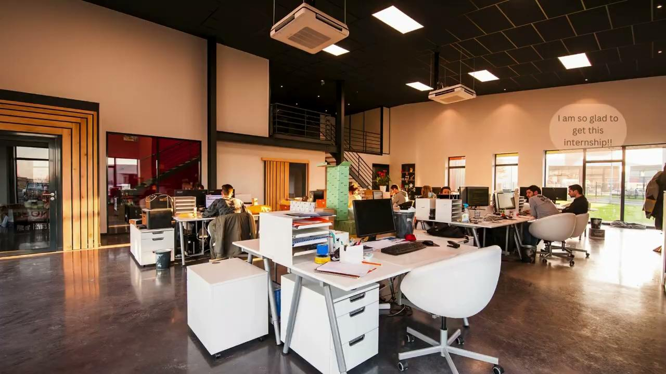

Slide 22
These are some screenshots from the code we wrote for implementation of ARIMA

Slide 23
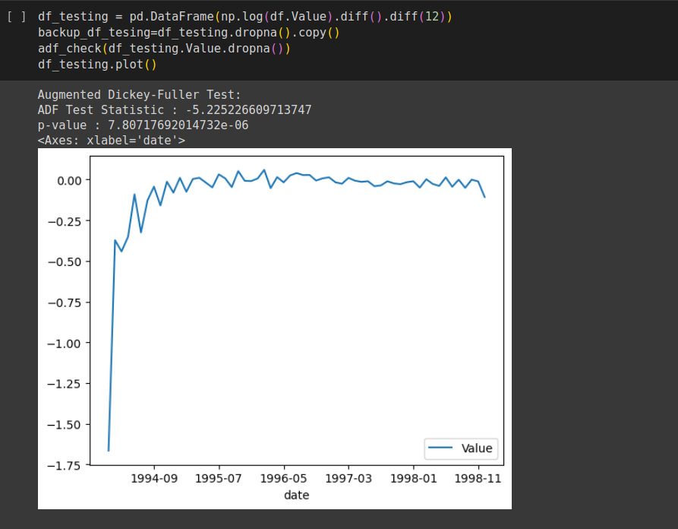

Slide 24
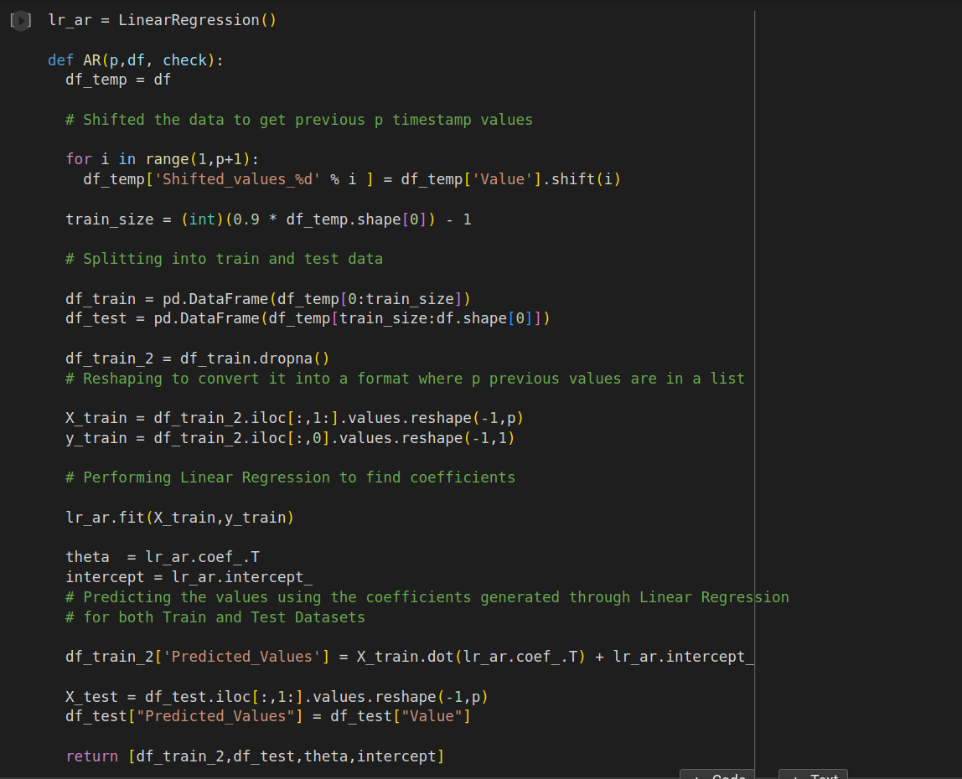

Slide 25
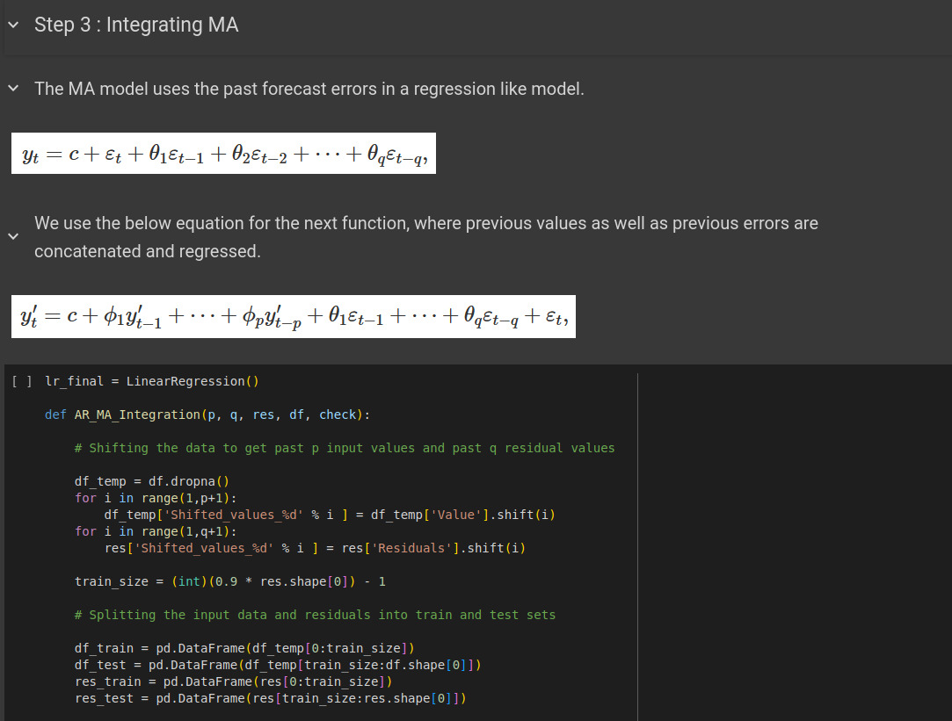

Slide 26
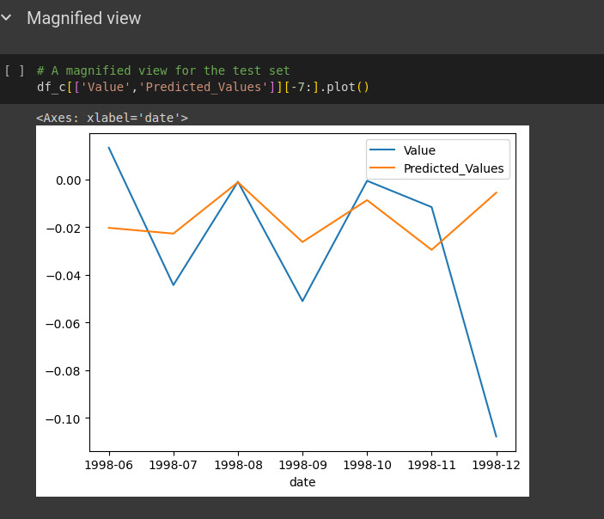

Slide 27
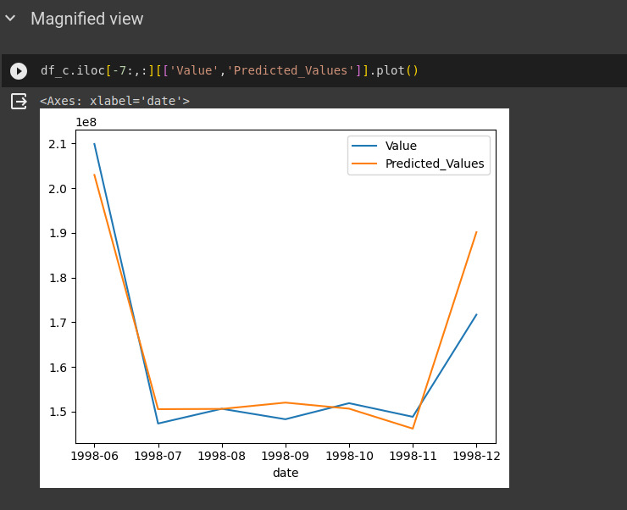

Slide 28
Contribution
Yash:- Explored various sources and learnt about ARIMA model. Majorly involved in scripting of the animation and the theory part. Created most of the animations for the video series. Voiceover for the first 5 videos. Learnt basic animation and video editing skills. Decided on the appropriate animation tools, video editor and recording software. Helped in reviewing the code and helping in the change of implementation.
Sankalp:- Looked up for various resources of ARIMA for understanding the related concepts. Worked towards implementation of code for ARIMA in python. Contributed in scripting of the videos and provided components for animations and images, graphs and required materials for slides for the videos. Did the voiceover for the 6th video.

Slide 29
The OneDrive link for our videos is:
https://iiitaphyd-my.sharepoint.com/:f:/g/personal/sankalp_bahad_research_iiit_ac_in/EllvpxXM-6dLgrM5It5iv0gBOhNGTpY0YTFBdgYMoPdpYg?e=lJRztv

Slide 30
Bibliography
Reference Youtube Links
https://www.youtube.com/watch?v=-aCF0_wfVwY
https://youtu.be/5-2C4eO4cPQ?si=pslM2mbsyzAQI1gE
https://youtu.be/voryLhxiPzE?si=B9Yl2FxLXxeTYk2F
https://youtu.be/_tgB-ri9-8c?si=s8SCDlmRm9qe7goy
https://youtu.be/3UmyHed0iYE?si=PhVkWgpKw7V-rgLk
https://www.youtube.com/playlist?list=PLqYFiz7NM_SMC4ZgXplbreXlRY4Jf4zBP

Slide 31
Bibliography (Continued.)
Reference Books:
https://otexts.com/fpp2/arima.html
https://warin.ca/ressources/books/2016_Book_IntroductionToTimeSeriesAndFor.pdf#page=100&zoom=100,270,876
https://faculty.washington.edu/dbp/s519/PDFs/13-overheads-2020.pdf
https://www2.stat.duke.edu/~cr173/Sta444_Sp17/slides/Lec10.pdf
https://online.stat.psu.edu/stat501/book/export/html/996
https://online.stat.psu.edu/stat501/lesson/t/t.2/t.2.1-autoregressive-models
https://online.stat.psu.edu/stat510/lesson/2/2.1

Slide 32
Bibliography (Continued.)
Reference Articles:
https://stats.stackexchange.com/questions/131128/what-exactly-is-the-box-jenkins-method-for-arima-processes
http://repo.darmajaya.ac.id/4781/1/Time%20Series%20Analysis_%20Forecasting%20and%20Control%20%28%20PDFDrive%20%29.pdf
https://www.jstor.org/stable/2669408?seq=2
https://www.analyticsvidhya.com/blog/2021/10/a-comprehensive-guide-to-time-series-analysis/
https://www.investopedia.com/terms/a/autoregressive.asp
https://github.com/liannewriting/YouTube-videos-public/blob/main/arima-model-time-series-prediction-python/time-series-arima.ipynb
https://medium.com/@ritusantra/stationarity-in-time-series-887eb42f62a9
https://towardsdatascience.com/stationarity-assumption-in-time-series-data-67ec93d0f2f
https://neptune.ai/blog/arima-sarima-real-world-time-series-forecasting-guide

Slide 33
Thank You

